Slide 1

Amazon capstone project
Shraddha saraswat

Slide 2

AGENDA
Introduction
The major aim of this project is to gain insight into the sales data of Amazon to understand the different factors that affect sales of the different branches.
Objective: Analyze sales transactions and customer details across three cities: Mandalay, Yangon, and Naypyitaw.
Data Size: 1000 rows and 17 columns covering sales transactions, customer details, and more.
Cities Analyzed: Mandalay, Yangon, Naypyitaw.
Analysis Scope: Focus on sales trends, customer preferences, profitability, and ratings across the three cities to identify insights and optimize strategies.

Slide 3
Data overview
Invoice ID: Unique sales transaction identifier.
Branch: Location of the sales transaction.
City: City where the branch is located.
Customer Type: Type of customer (e.g., Member, Normal)
Gender: Gender of the purchasing customer.
Product Line: Type or category of the product sold.
Payment Method: Method used to pay for the purchase (e.g., Cash, Credit Card, Ewallet)
Rating: Customer rating for the purchase experience.

Slide 4

Feature engineering
Add Time of Day Column
New Column: "timeofday"
Purpose: Identify peak sales times during the day.
Add Day Name Column
New Column: "dayname"
Content: Extracted days of the week (Mon, Tue, Wed, Thu, Fri)
Purpose: Determine busiest days for each branch.
Add Month Name Column
New Column: "monthname"
Content: Extracted months of the year (Jan, Feb, Mar)
Purpose: Identify months with the highest sales and profit.
This Photo by Unknown Author is licensed under CC BY-ND

Slide 5
Product analysis
Top-Performing Product-Line
Food and beverages ( 56144.84)
Electronic Accessories (971 units)
Underperforming Product-Line
Health and beauty ( 49193.74)
Health and beauty (854 units)

Slide 6
Sales Analysis
Objective: To analyze sales data and extract key insights to optimize business strategies.
Key Findings:
Monthly Revenue (January): Achieved a revenue of 116,291.87 in January.
Sale Peak Times:
Afternoon: Highest sales quantity with 2946 units sold.
Evening: Significant sales with 1526 units sold.
Morning: Moderate sales with 1038 units sold.
Highest Sales Month: Identified January as the month with the highest sales volume.

Slide 7

Customer analysis
Objective: Uncovering Our Key Customer Insights
Most Frequent Customer Type: Members are our core base, demonstrating unwavering loyalty and brand engagement.
Highest Revenue Contribution: Members (164,223.44) are our top revenue generators, emphasizing their critical role in our business success.
Predominant Gender: Females dominate our member base, shaping our marketing strategies to cater effectively to this key demographic trend.

Slide 8

Business Insights (Questions & Answers)
1.Count of distinct cities
2.Branches and corresponding cities.
QUERIES
Yangon
Naypyitaw
Mandalay
select distinct city from amazon;
select distinct Branch, City from amazon;
A | Yangon
C | Naypyitaw
B | Mandalay

Slide 9
3.What is the count of distinct product lines in the dataset?
Health and beauty
Electronic accessories
Home and lifestyle
Sports and travel
Food and beverages
Fashion accessories
4.Which payment method occurs most frequently?
Ewallet
5.Which product line has the highest sales?
Food and beverages - 56144.84
6.How much revenue is generated each month?
Jan | 116291.87
Mar | 109455.51
Feb | 97219.37
Jan | 116291.87
Mar | 109455.51
Feb | 97219.37

Slide 10
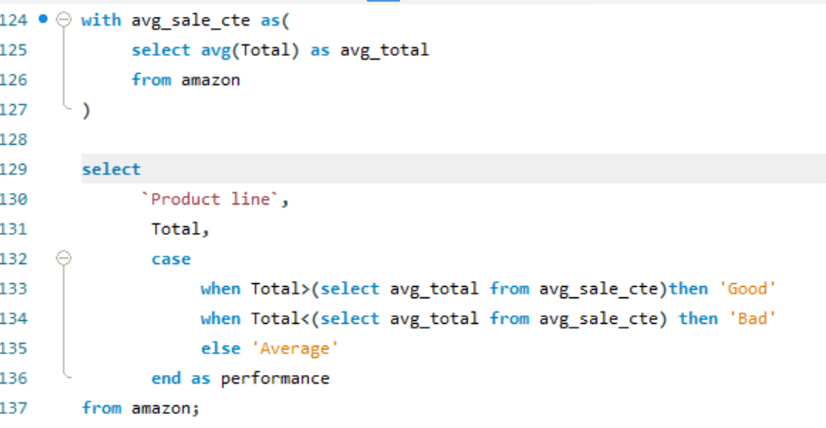
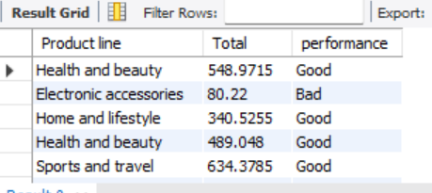
7. In which month did the cost of goods sold reach its peak?
Jan - | 116291.87
8. Which product line generated the highest revenue?
Food and beverages | 56144.84
9. In which city was the highest revenue recorded?
Naypyitaw | 110568.71
10.Which product line incurred the highest Value Added Tax?
Food and beverages | 2673.56
11.For each product line, add a column indicating "Good" if its sales are above average, otherwise "Bad."

Slide 11
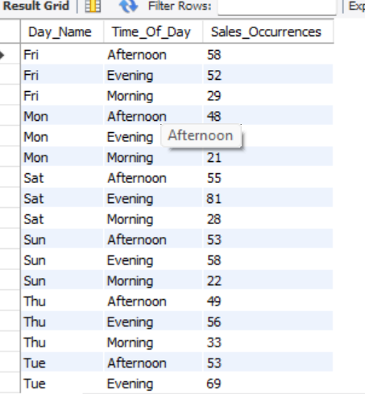
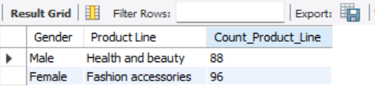
12.Identify the branch that exceeded the average number of products sold.
A - | 1859
A - | 1859
13. Which product line is most frequently associated with each gender?
14. Calculate the average rating for each product line.
Home and lifestyle | 6.8375
15. Count the sales occurrences for each time of day on every weekday.

Slide 12
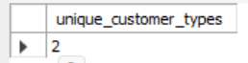
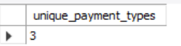
16. Identify the customer type contributing the highest revenue.
Member | 164223.44
17. Determine the city with the highest VAT percentage.
Naypyitaw | 5265.18
18. Identify the customer type with the highest VAT payments
Member | 7820.16
19. What is the count of distinct customer types in the dataset?
20. What is the count of distinct payment methods in the dataset?

Slide 13
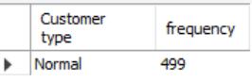
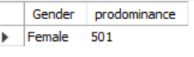
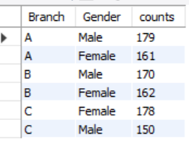
21. Which customer type occurs most frequently?
22. Identify the customer type with the highest purchase frequency.
Member | 164223.44
23. Determine the predominant gender among customers.
24. Examine the distribution of genders within each branch.

Slide 14
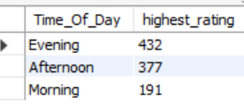
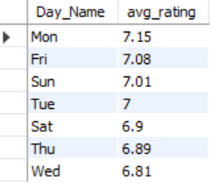
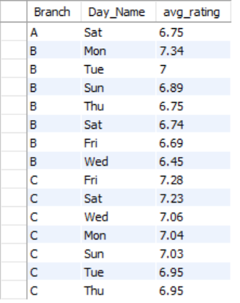
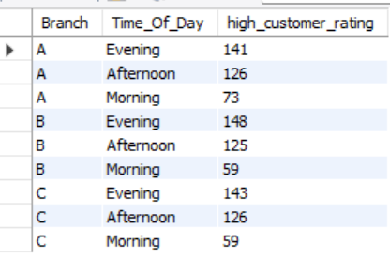
25. Identify the time of day when customers
provide the most ratings.
27. Identify the day of the week with the highest average ratings.
26. Determine the time of day with the highest customer ratings for each branch.
28. Determine the day of
the week with the highest
average ratings for each
branch.

Slide 15
Thank you
SHRADDHA SARASWAT

